Slide 1
To receive future information about local HEIW face to face events….
You need to join your ytydysgu dental network(s)

Slide 2
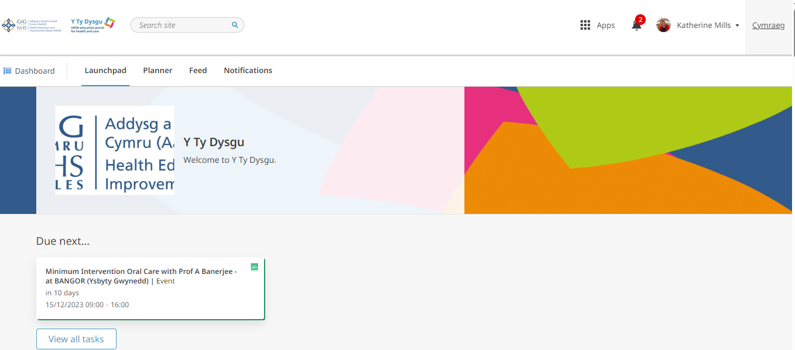
Sign in to ytydysgu in the usual way.
From your dashboard, select ‘APPS’

Slide 3
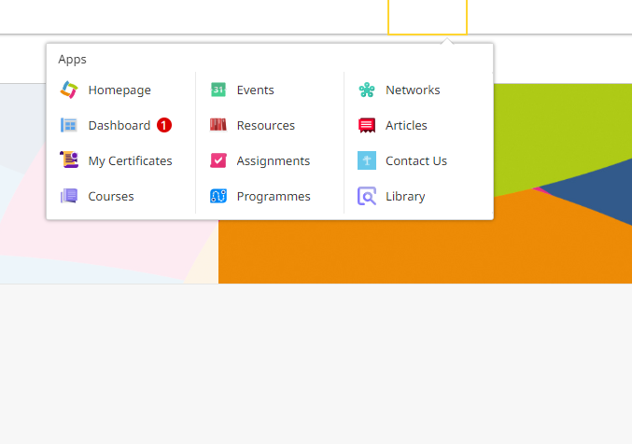
From ‘Apps’ select ‘Networks’

Slide 4
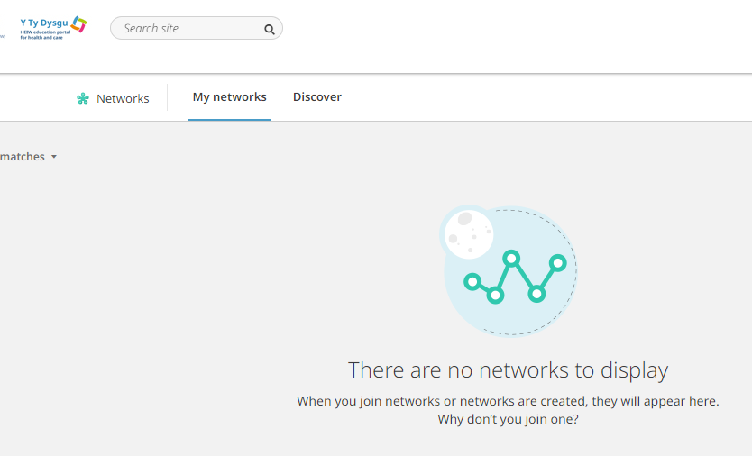

From ‘Networks’ select ‘ Discover’

Slide 5
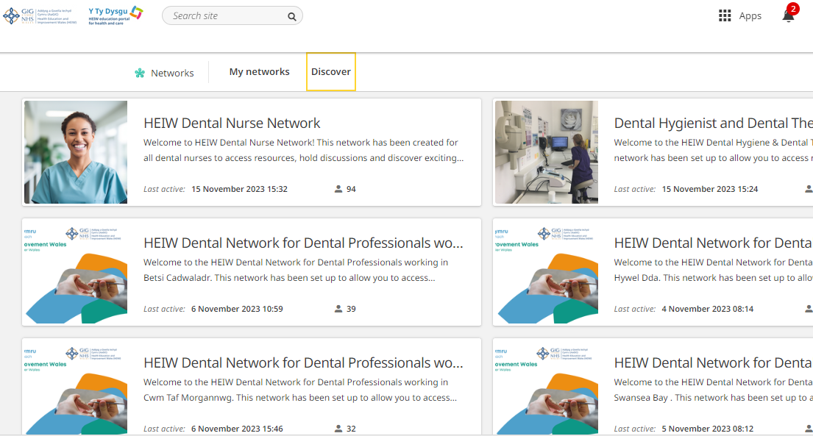
From ‘Discover’ select your local network

Slide 6
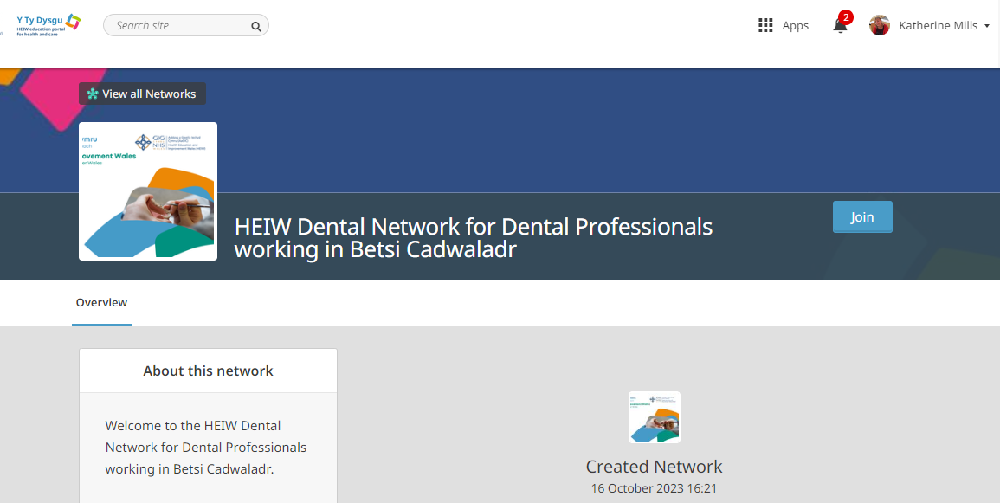
Click ‘join’

